Slide 1
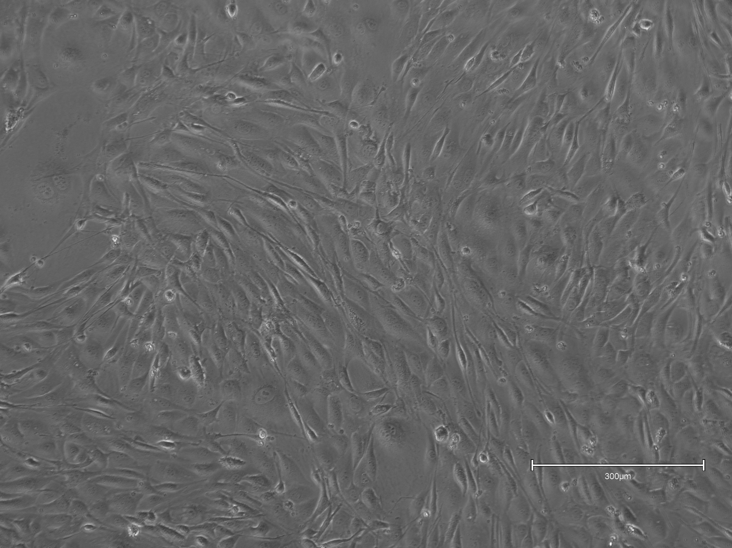
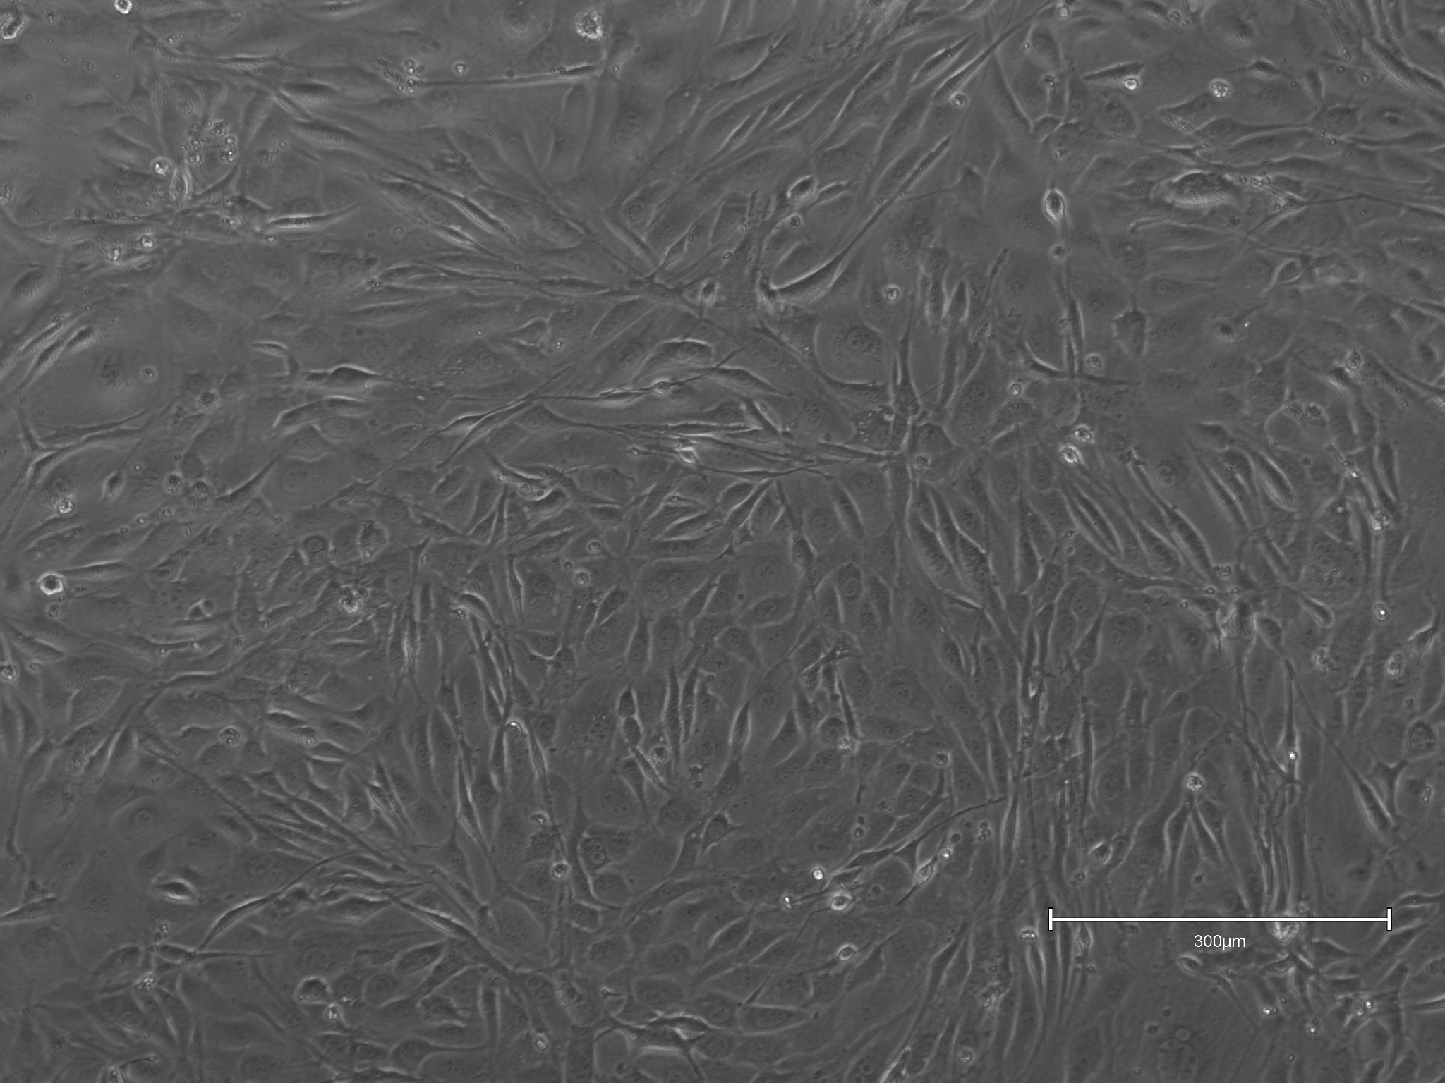
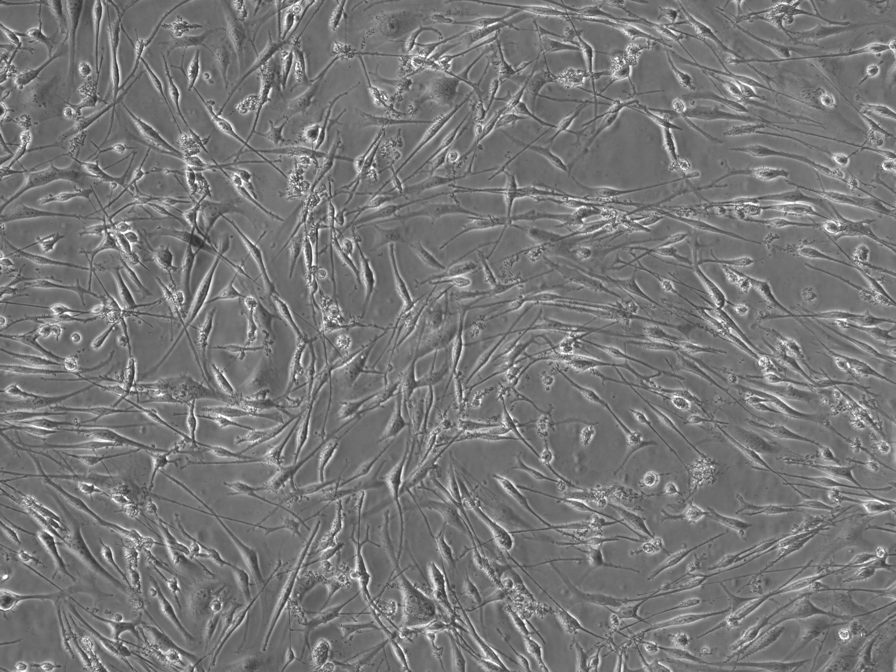
Bovine Platelet Lysate Test
Bovine Serum
Fetal Bovine Serum
Bovine Platelet Lysate (Plenty)
Day 4 Cell Count
(3 wells
pooled)
2.625$×{10}^{6}$
2.25$×{10}^{6}$
2.288$×{10}^{6}$

Slide 2
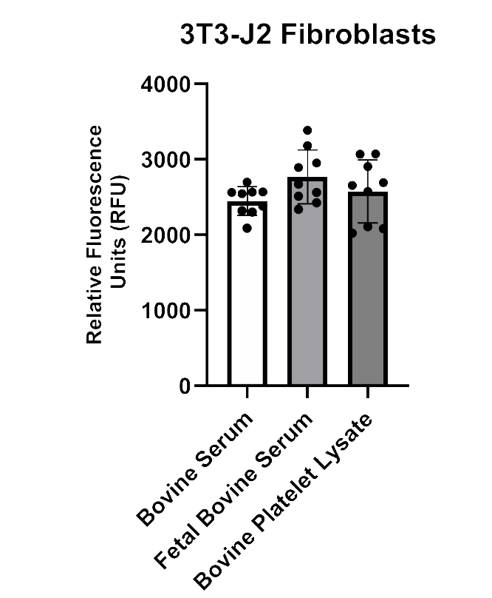
Bovine Platelet Lysate Test Presto Blue

